Slide 1
COMS0111 Computer Networks

Slide 2
Module 1: Introduction to Computer Networks Basics of computer networks: Definition, types (LAN, WAN, MAN), and uses. Network models: OSI and TCP/IP models. Data communication concepts: Components, data flow, and signal types. Transmission media: Wired and wireless (coaxial, fiber optics, radio waves, etc.). Network topologies and their characteristics.

Slide 3
A Computer Network is a set of computing devices interconnected through wired/wireless media for the purpose of sharing resources (like printers, etc.) and information (communication) .
They are interconnected collection of autonomous computers.
Any computer or computing devices are able to exchange information. (communication)
Connection can be wired/wireless via copper wire, fiber optics, microwaves, communication satellites etc

Slide 4
Uses of Computer Networks
Communication: Individuals and organizations can collaborate using communicational channels that may include email, chat, and video conferencing.
Resource sharing: Provide a way to share the printer, scanner, and files, which will help to improve work activities and reduce costs.
Remote access: Network technologies bring the power of information and assistance by making it accessible from anywhere on the globe.
Collaboration: Networks function to make collaboration by offering the opportunities to work jointly on something, share thoughts etc.
E-commerce: Online sales and payments processing are empowered with the computer networks, that enable businesses to sell products online and execute secure payments.
Education: From their use in the educational setting they are employed to provide a basis for distance learning, access to resources of higher education and give opportunity for collaboration among students and teachers.
Entertainment: Online gaming, online film and music streaming, and social networking.

Slide 5
Types of Computer Networks

Slide 6
Two types of computer networks based on:
Transmission Technology and Scale.
Based on the types of transmission technology.
Point-to-point Networks
Broadcast Networks
Based on Scale
PAN (personal area network)
LAN (local area network)
MAN (metropolitan area network)
WAN (wide area network)

Slide 7
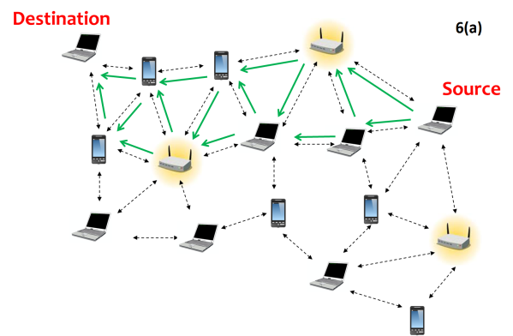
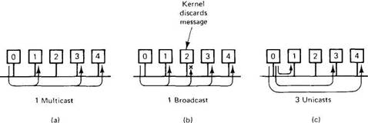
Point-to-point Networks
Connect between individual pair of machines.
Transfer of short messages called packets from source to destination may include one or more intermediate machines.
Multiple routes of different lengths– use routing algorithm for route selection.
Point-to-point transmission with one sender and one receiver is called unicasting.

Slide 8
Broadcast Networks
A single communication channel is shared by all the
machines on the network.
Short messages called packets sent by any machine are received by all the others.
Address field in a packet specifies the recipient.
After receiving the packet, the address field is checked.
If it is intended for itself, it processes the packet, otherwise it is ignored.
Eg. Wireless network is a broadcast link.
Broadcast systems allow the possibility of addressing a packet to all destinations by using a special code in the address field. (eg. An all 1’s address)
When a packet with this code is transmitted, it is received and processed by every machine on the network.

Slide 9
Multicasting:
Broadcast also support transmission to a subset of the machines.
By reserving a bit in the address to indicate multicasting & the remaining (n-1) address bits to hold the group number

Slide 10
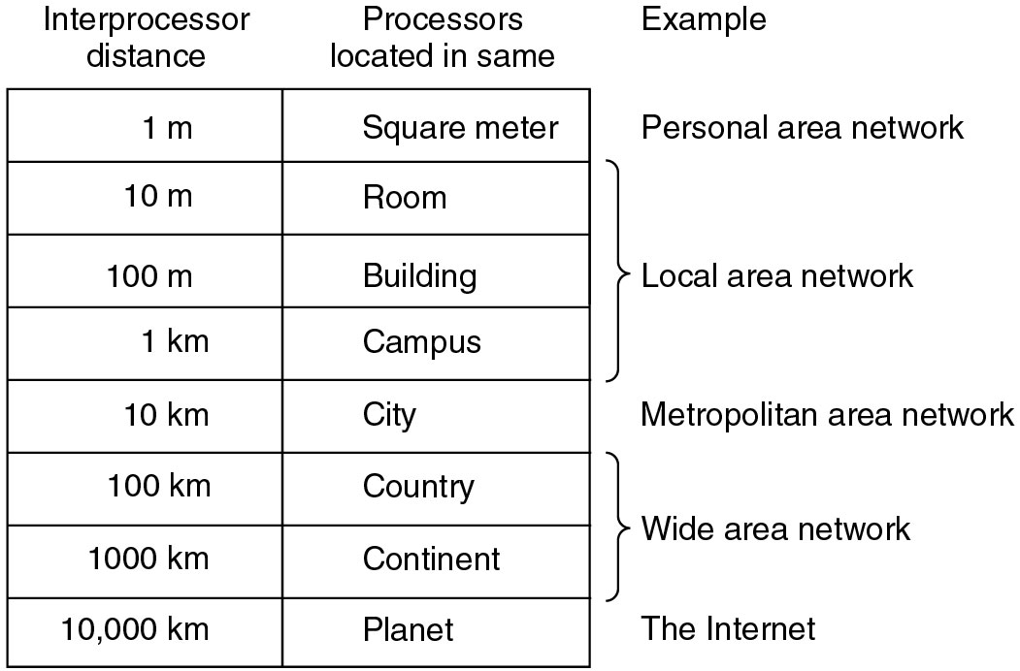
Network types based on Scale.
PAN
LAN
MAN
WAN
Internet

Slide 11
Personal Area Networks (PANs)
Networks that are meant in the range of a person. (few metres)
Eg.: A wireless network connecting a computer with its mouse, keyboard, and printer.
Eg.: Body Area Networks connecting smart watch, mobile, body sensors etc.
pacemaker, insulin pump, or hearing aid talks to a user-operated remote control.
Eg. RFID on smartcards and library books.
Transmission Technologies: Wired, or Wireless like WiFi.

Slide 12
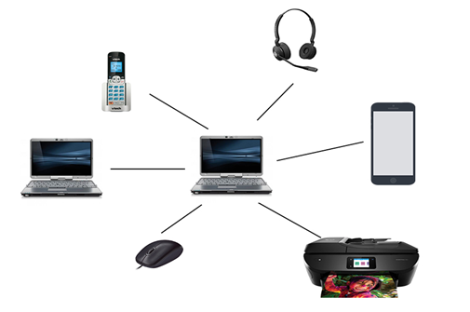
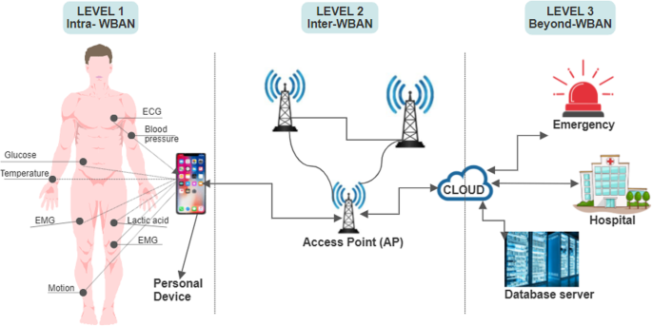
PAN Examples
1. Wireless Home Network
2. Body Area Network

Slide 13
Local Area Networks (LANs)
A group of computers that provide reliable, high speed communication channels for resource sharing in a small geographical area such as campus, office, etc.
Used to share resources (hardware or software) and to exchange information.
Privately owned networks.
LANs used by companies are called enterprise networks.
IEEE 802 standard. Eg. Ethernet LAN is IEEE 802.3.
Wireless LANs are very popular, in homes, old buildings, cafes, and other places where it is trouble to install cables.
An access point or wireless router enables communication through Internet.

Slide 14
LANs are distinguished by 3 characteristics:
Size
Transmission Technology
Topology
Size restriction:
Spans few kilometres: Inter-processor distance:10m to 1km.
Traditional LAN runs at speed of 10 to 100 Mbps; newer LANs operate at 10 Gbps.
Low delay - as short as microseconds (ms) or nanoseconds (ns).
Makes very few errors.
Worst-case transmission time is bounded and known in advance.
Knowing these bounds helps in designing network protocols.
Simplifies network management.

Slide 15
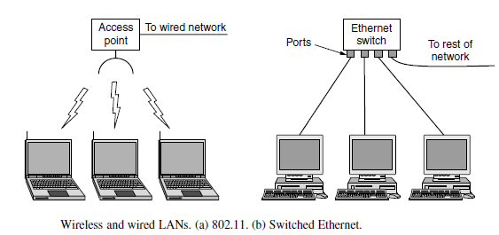
Wired LANs use a range of different transmission technologies.
Most of them use copper wires, but some use optical fiber.
Wired LANs exceeds wireless LANs in performance - reliable to send signals over a wire or through a fiber than through the air.

Slide 16
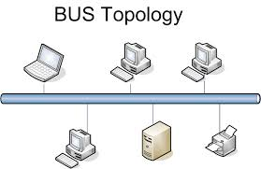
The topology of many wired LANs is built from point-to-point links.
Most common wired LAN - IEEE 802.3, popularly called Ethernet.
Other examples - Token Ring (IEEE 802.3), Token Bus, FDDI etc.
Original Ethernet uses bus topology and broadcasts all the packets over a single linear cable.
At most one machine could successfully transmit at a time, and a distributed control mechanism was used to resolve conflicts.
It used a simple algorithm:
Computers could transmit whenever the cable was idle.
If two or more packets collided, each computer just waited a random time and tried later.

Slide 17
Switched Ethernet: Each computer speaks the Ethernet protocol and connects to a switch with a point-to-point link. Hence the name.
A switch has multiple ports, each can connect to one computer.
The switch will relay packets between computers that are attached to it, using the address in each packet to determine which computer to send it to.
To build larger LANs, switches can be plugged into each other.
Ring Topology: A second type of broadcast LANs.
In a ring, each bit propagates around on its own, not waiting for the rest of the packet to which it belongs.
Simultaneous accesses controlled by a token.
Eg. IEEE 802.5 (the IBM Token Ring),
FDDI (Fiber Distributed Data Interface).

Slide 18
Metropolitan Area Networks (MAN):
Larger than LANs.
Covers a larger geographical area like a city and its surroundings.
5 to 50 km or more diameter.
Eg. Cable television networks.
Recent developments in highspeed wireless Internet access have resulted in WiMAX, standardized as IEEE 802.16
MANs can be created by interconnecting two LANs.
Not commonly owned and maintained by a single organization.
Either a group of users or a single network provider owns the communication inks and equipment of MAN.
Like a large LAN, MAN also works as a high-speed network, which allows the sharing of local resources.

Slide 19
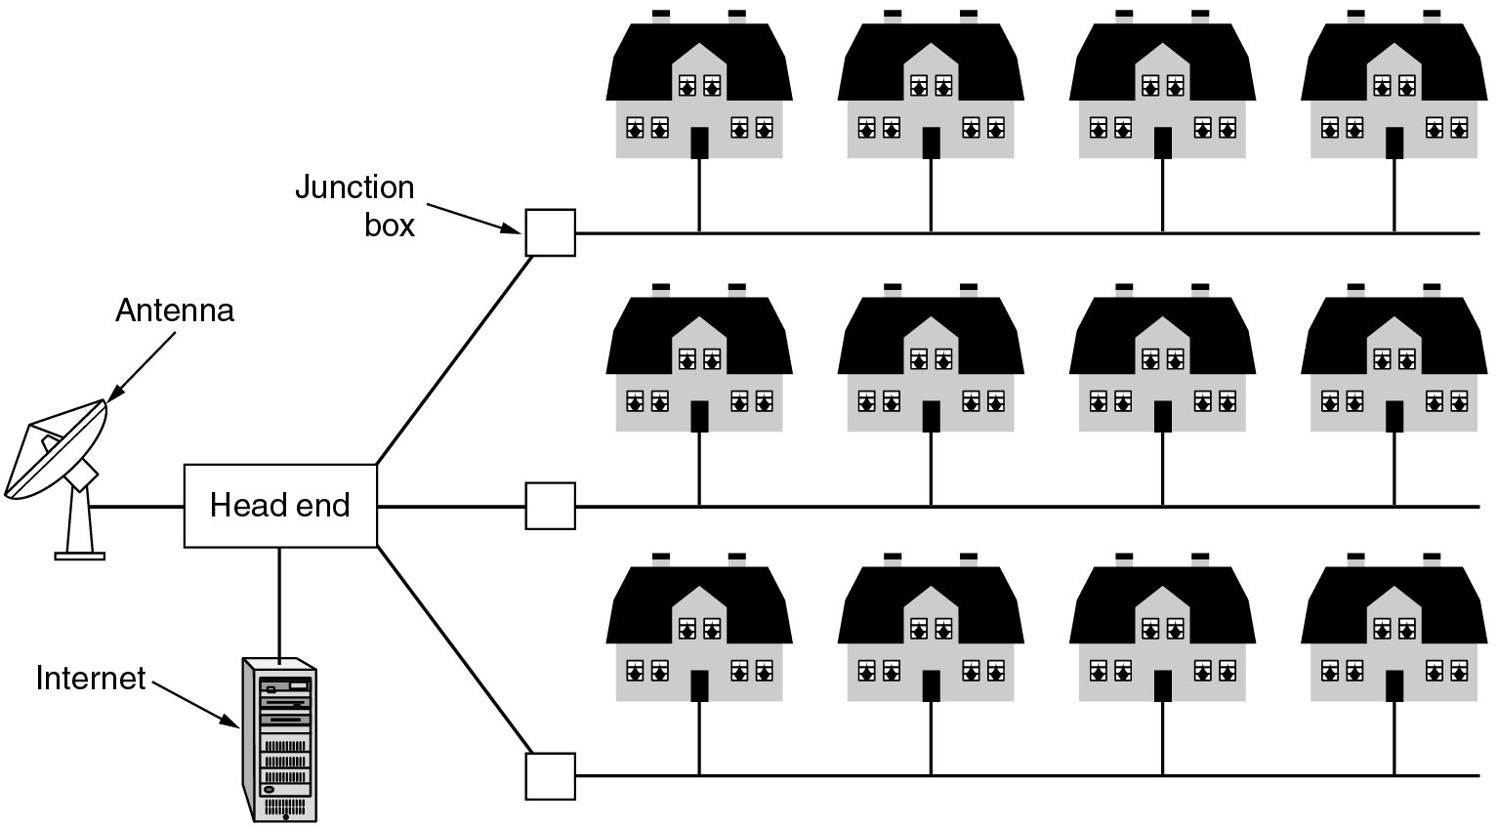
Advantages of MAN:
It provides and manages services to large number of clients.
Error rates are moderate.
Disadvantages of MAN:
It need huge space to set-up.
Its speed of accessing data is less.
Equipment used in MAN is expensive.
A metropolitan area network based on cable TV in a city.

Slide 20
Wide Area Networks (WANs):
Eg. Internet
WAN connect devices of a larger geographical area (beyond the LAN and MAN), spans often a country or continent.
Uses common carriers like satellite systems, telephone line, etc. to facilitate the transmission.
It contains a collection of machines called hosts intended for running user (application) programs. (owned by the customers)
The hosts are connected by a communication subnet. (owned and operated by a telephone company or Internet Service Provider)
The job of the subnet is to carry messages from host to host, just as the telephone system carries words from speaker to listener.
It also acquired a second meaning in conjunction with network addressing.

Slide 21
Subnet consists of two distinct components:
Transmission lines and Switching elements
Transmission lines:
Move bits between machines.
Made of copper wire, optical fiber, or even radio links.
Most companies lease the lines from a telecommunications company.
Switching elements (switches) / Routers:
Specialized computers that connect three or more transmission lines.
When data arrive on an incoming line, it must choose an outgoing line on which to forward them.
Switching elements are also called as routers.

Slide 22
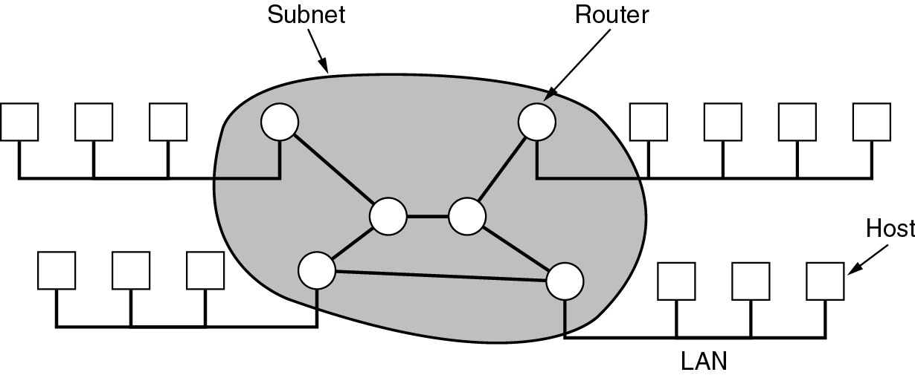
Relation between hosts on LANs and the subnet.
Each host is connected to a LAN on which a router is present.
In some cases a host can be connected directly to a router.
The collection of communication lines and routers (but not the hosts) form the subnet.

Slide 23
Store-and-forward or packet-switched subnet:
The WAN contains numerous transmission lines, each one connecting a pair of routers.
If two routers that do not share a transmission line wish to communicate, they must do this indirectly, via other routers.
When a packet is sent from one router to another via one or more intermediate routers,
the packet is received at each intermediate router in its entirety, stored there briefly until the required output line is free, and then forwarded.
If error occurs, packet may be retransmitted.
When the packets are small and all of the same size, they are often called cells.
Notes:
In most WANs, the network contains numerous transmission lines, each one connecting a pair of routers. If two
routers that do not share a transmission line wish to communicate, they must do this indirectly, via other routers.
When a packet is sent from one router to another via one or more intermediate routers, the packet is received at
each intermediate router in its entirety, stored there until the required output line is free, and then forwarded. A
subnet organized according to this principle is called a store-and-forward or packet-switched subnet. Nearly all
wide area networks (except those using satellites) have store-and-forward subnets. When the packets are small
and all the same size, they are often called cells.

Slide 24
Principle of a packet-switched WAN:
When a process on some host has a message to be sent to a process on some other host, the sending host first divide the message into smaller pieces called packets, each one bearing its number in the sequence.
These packets are then injected into the network one at a time in quick succession.
The packets are transported individually over the network and deposited at the receiving host, where they are reassembled into the original message and delivered to the receiving process.
In some networks, all packets from a given message may follow the same route; in others each packet is routed separately.
Best route can be chosen using routing algorithms.

Slide 25
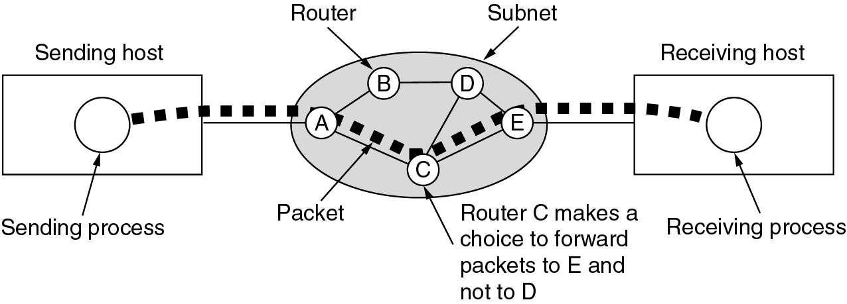
A stream of packets from sender to receiver.
How the network makes the decision as to which path to use? Routing algorithm.
How each router makes the decision as to where to send a packet next? made locally using Forwarding algorithm.
Notes:
In this figure, all the packets follow the route ACE, rather than ABDE or ACDE. In some networks all packets from a given message must follow the same route; in others each packet is routed separately. Of course, if ACE is the best route, all packets may be sent along it, even if each packet is individually routed.
Routing decisions are made locally. When a packet arrives at router A,itis up to A to decide if this packet should be sent on the line to B or the line to C. How A makes that decision is called the routing algorithm. Many of them exist.

Slide 26
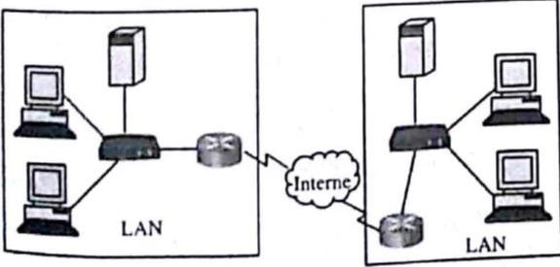
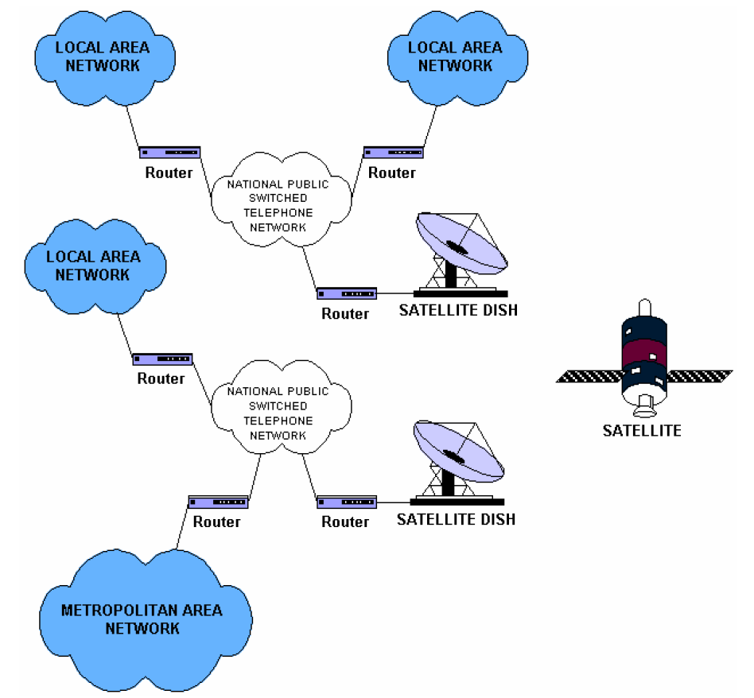
Notes:
Not all WANs are packet switched.
A second possibility for a WAN is a satellite system.
Each router has an antenna through which it can send and receive.
All routers can hear the output from the satellite
In some cases, they can also hear the upward transmissions of their fellow routers to the satellite as well.
Sometimes the routers are connected to a substantial point-to-point subnet, with only some of them having a satellite antenna.
Satellite networks are inherently broadcast and are most useful when the broadcast property is important

Slide 27
Internetworks
Internetwork: A collection of interconnected networks is called an internetwork or internet.
Eg. a collection of LANs connected by a WAN.
Subnet is a collection of routers and communication lines owned by the network operator.
A network like WAN is formed by the combination of a subnet and its hosts.
An internetwork is formed when distinct networks are interconnected.
How two different networks can be connected?
A gateway device makes a connection between two or more different networks and provides the necessary translation, both in terms of hardware and software.

Slide 28
